Slide 1

Back-end side
PHP

Slide 2
What is PHP ?
PHP is a server scripting language.
Used for making dynamic and interactive Web pages.
PHP code is executed on the server, and the result is returned to the browser as plain HTML

Slide 3
Purpose of PHP
PHP can generate dynamic page contents, by retrieving data from the database dynamically.
PHP can handle form data (add, delete, modify data) in your database.

Slide 4
Example on Back-end side of a website
Sign up and Login are done on the back-end side of a website.
When a user fills his username and password, and any other required information to create an account, these information is handled by PHP, then stored in the database.
When a user wants to login to a website, PHP handles the login process by checking if the username exists in the database and also checks if the entered password is correct and accordingly PHP directs him to the home page with his information, or it prevents him from logging in if the username and password are incorrect.

Slide 5

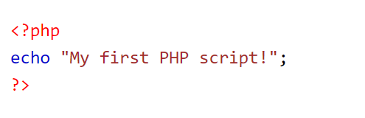


PHP Syntax
The beginning of PHP code
PHP code goes here
The ending of PHP code
http://localhost/Tutorial/example1.php

Slide 6
PHP File
Can contain HTML,CSS and JavaScript.
Must have .php as extension
To run on Xammp must be stored in specific directory

Slide 7
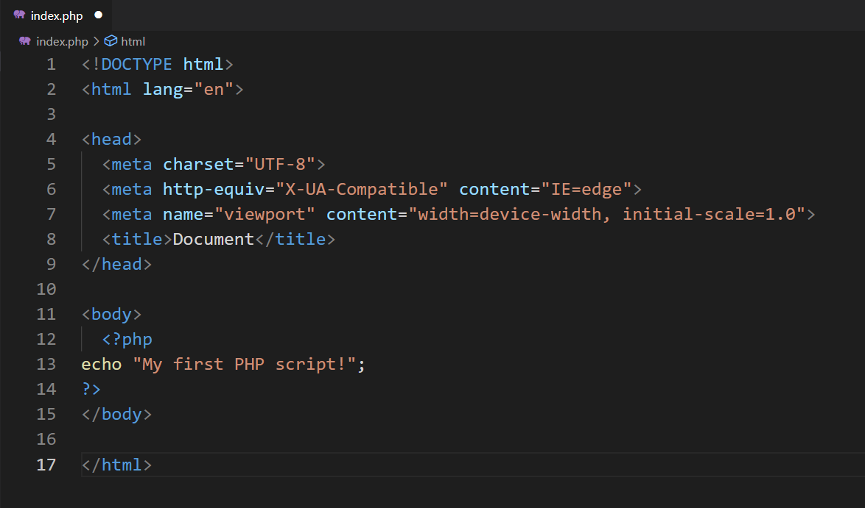
PHP File
Must have .php extension.
PHP file Can contain html tags, css styles, JavaScript code, and PHP code.
http://localhost/Tutorial/example2.php

Slide 8
Environment Setup
1- Download xampp from https://www.apachefriends.org/download.html
2- Install Xampp
3- Launch apache
4- Navigate to C:\xampp\htdocs directory where PHP files should be saved.

Slide 9
Where to save our PHP files
C:\xampp\htdocs

Slide 10
What is XAMPP ?
XAMPP is a cross-platform web server that is free and open-source. XAMPP is a short form for Cross-Platform, Apache, MySQL, PHP, and Perl.
XAMPP is a popular cross-platform web server that allows programmers to write and test their code on a local webserver.

Slide 11
Why XAMPP ?
XAMPP is simply a local host or server.
This local server runs on your personal computer, whether it’s a desktop or a laptop.
It is used to test clients or websites before publishing them to a remote web server.
On a local computer, the XAMPP server software provides a suitable environment for testing MYSQL, PHP, Apache, and Perl projects. Because most real-world web server deployments share the same components as XAMPP, moving from a local test server to a live server is straightforward.

Slide 12
What does Webserver do?
Accepts the request from a web browser
Finds the requested document
Sends the document back to the browser through HTTP/HTTPS
If the server doesn't find the requested document, it returns a 404response instead
Notes:
https://www.educba.com/what-is-xampp/

Slide 13
Let’s create our PHP File

Slide 14
Print statement
Notes:
Echo
Or
Print

Slide 15
PHP Comments
Notes:
//
#

Slide 16
PHP Variables
Notes:
<?php $txt = "Hello world!"; $x = 5; $y = 10.5; ?>
--------------------------------------
<?php $txt = "W3Schools.com"; echo "I love $txt!"; ?>

Slide 17
PHP Var_dump()
Notes:
<!DOCTYPE html>
<html>
<body>
<?php
$x = 5985;
VAR_DUMP($x);
?>
</body>
</html>

Slide 18
PHP Local+ Global variables
Notes:
<?php $x = 5; $y = 10; function myTest() { global $x, $y; $y = $x + $y; } myTest(); echo $y; // outputs 15 ?>

Slide 19
PHP Case Sensitivity
Notes:
PHP is case sensitive for user defined variables

Slide 20
PHP Concatenation
Notes:
<?php $txt = "W3Schools.com"; echo "I love " . $txt . "!"; ?>

Slide 21
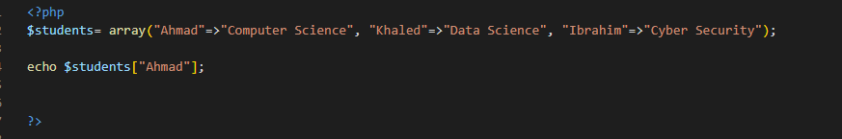

Array Key => value
Use key to get the value

Slide 22
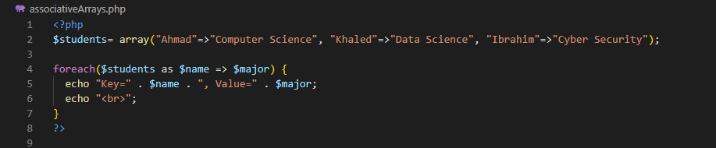

Associative Arrays
Use foreach to get array element by element and print key and value pairs

Slide 23

print_r
Use print_r to print key value pairs

Slide 24
Super globals
https://www.w3schools.com/php/php_superglobals.asp
$GLOBALS
$_SERVER
$_REQUEST
$_POST
$_GET
$_FILES
$_ENV
$_COOKIE
$_SESSION

Slide 25
Super globals
Are associative arrays: keys are used to get the values
Keys come from the name attribute in the html input tags.

Slide 26
How to handle data filled in form
Form methods
Post
Get
$_POST
$_GET
action
$_REQUEST

Slide 27
Get
Vs.
Post
The data is sent in the query string (name/value pairs in the URL of a GET request
GET requests can be cached
GET requests remain in the browser history
GET requests can be bookmarked
GET requests should never be used when dealing with sensitive data
GET requests have length restrictions, the GET method adds the data to the URL; and the length of a URL is limited (maximum URL length is 2048 characters)
The data sent to the server with POST is stored in the request body of the HTTP request.
POST requests are never cached
POST requests do not remain in the browser history
POST requests cannot be bookmarked
POST requests have no restrictions on data length

Slide 28

HTTP Is stateless
A stateless protocol does not require the server to retain information or status about each user for the duration of multiple requests.

Slide 29

But some web applications may have to track the user's progress from page to page, for example when a web server is required to customize the content of a web page for a user.
Solutions for these cases include:
the use of HTTP cookies.
Server-side sessions.
hidden variables (when the current page contains a form)
URL-rewriting using URI-encoded parameters, e.g., /index.php?var1=value1&var2=value2.

Slide 30
Difference Between Session and Cookies
https://www.scaler.com/topics/session-and-cookies-in-php/
https://www.geeksforgeeks.org/difference-between-session-and-cookies/

Slide 31
See code Samples
http://localhost/Tutorial/

